Slide 1
Essex Police Challenge
Local Policing
27th February 2014

Slide 2
The Future of Local Policing
19:30 PCC introduction
Performance and standards in key areas of local policing
Questions from the public
20:00 Your local policing team
Resolving local problems
Named points of contact
PCSOs are integral
Questions from the public
20:30 Engagement
The changing role of NAPs
New means of contact
Partnership working
Questions from the public
21:00 Open Question session
Dedicated to questions from the public

Slide 3
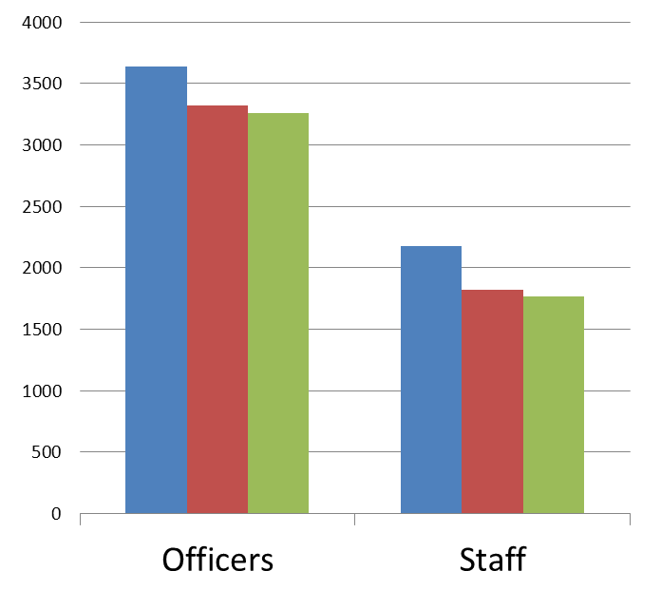
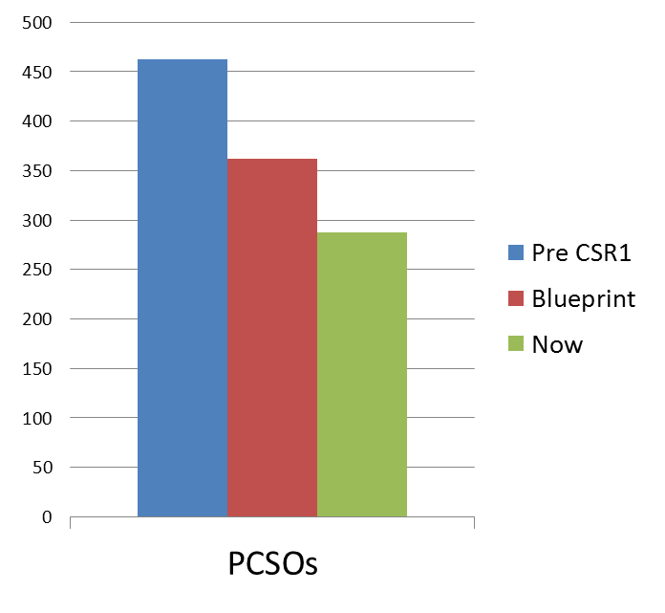
Policing numbers

Slide 4
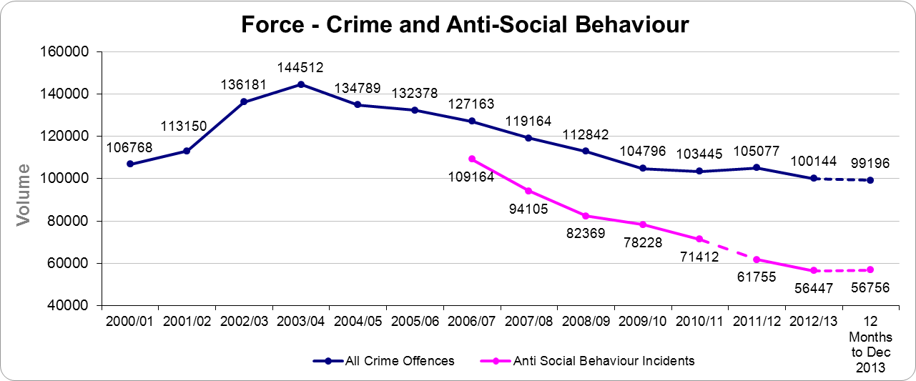
Reducing Crime & Anti-Social Behaviour

Slide 5
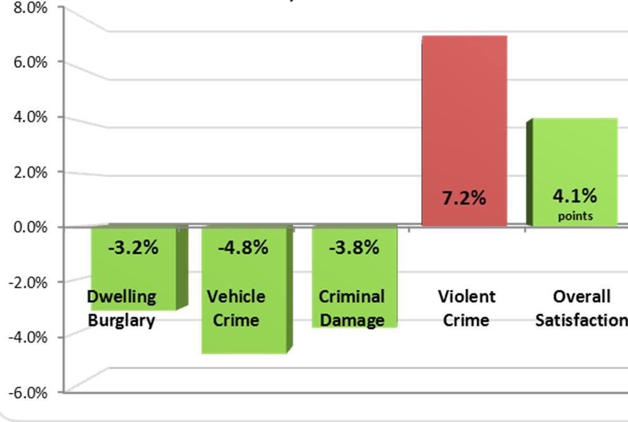
Crime Reduction & Satisfaction

Slide 6
Driving Down House Burglaries
Burglary initiative
launched 01/10/2013

Slide 7
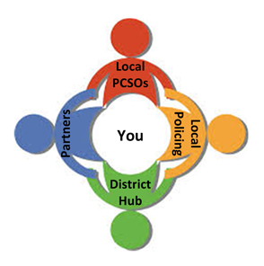
Local Policing
Locally based and locally accountable
Good understanding of communities
Response / investigation / visibility / long term problem solving
Targeting local offenders
Supporting local victims
Working with local partners

Slide 8
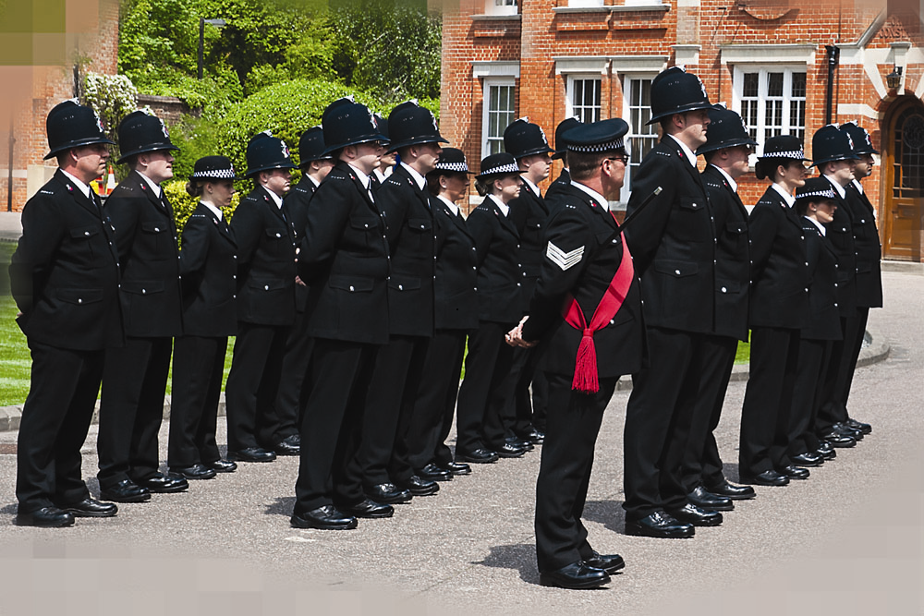
Local Policing Hub & Standards
District Commander – responsible for local policing
Policing will be visible and responsive
New district based problem solving hubs
Key, named points of contact for communities
Understand and solve local problems
Respond to all contact within 2 days

Slide 9
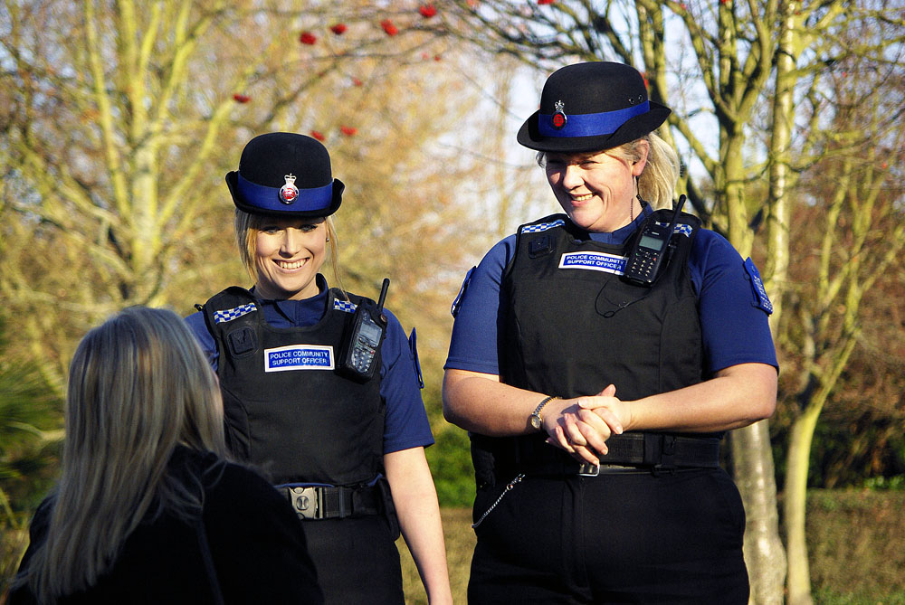
The Future Role of PCSOs
Integral part of local policing model
Focus on local community priorities
Designated patch for every PCSO
Attend nearly 20% of all calls
Expanding the role of PCSOs to support local crime investigation

Slide 10
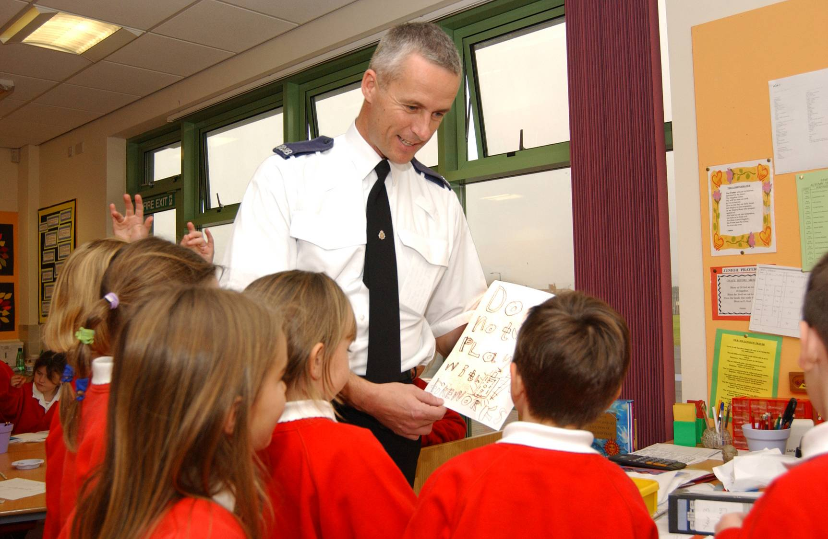
Community Engagement
Continuing commitment to community meetings
Weekly beat surgeries
Local police and community meetings – the new NAPs
2 way - give & receive advice/information
Agree action against local community problems

Slide 11
Modernising Contact with Essex Police
35.7m people in UK use the internet daily (73% of population) compared to just 16.2m in 2006
7 in 10 people in the UK own a smart phone
Police stations are important but the force will invest in new methods of contact
Training & technology lead to a better and faster service
Fewer but better quality police buildings

Slide 12
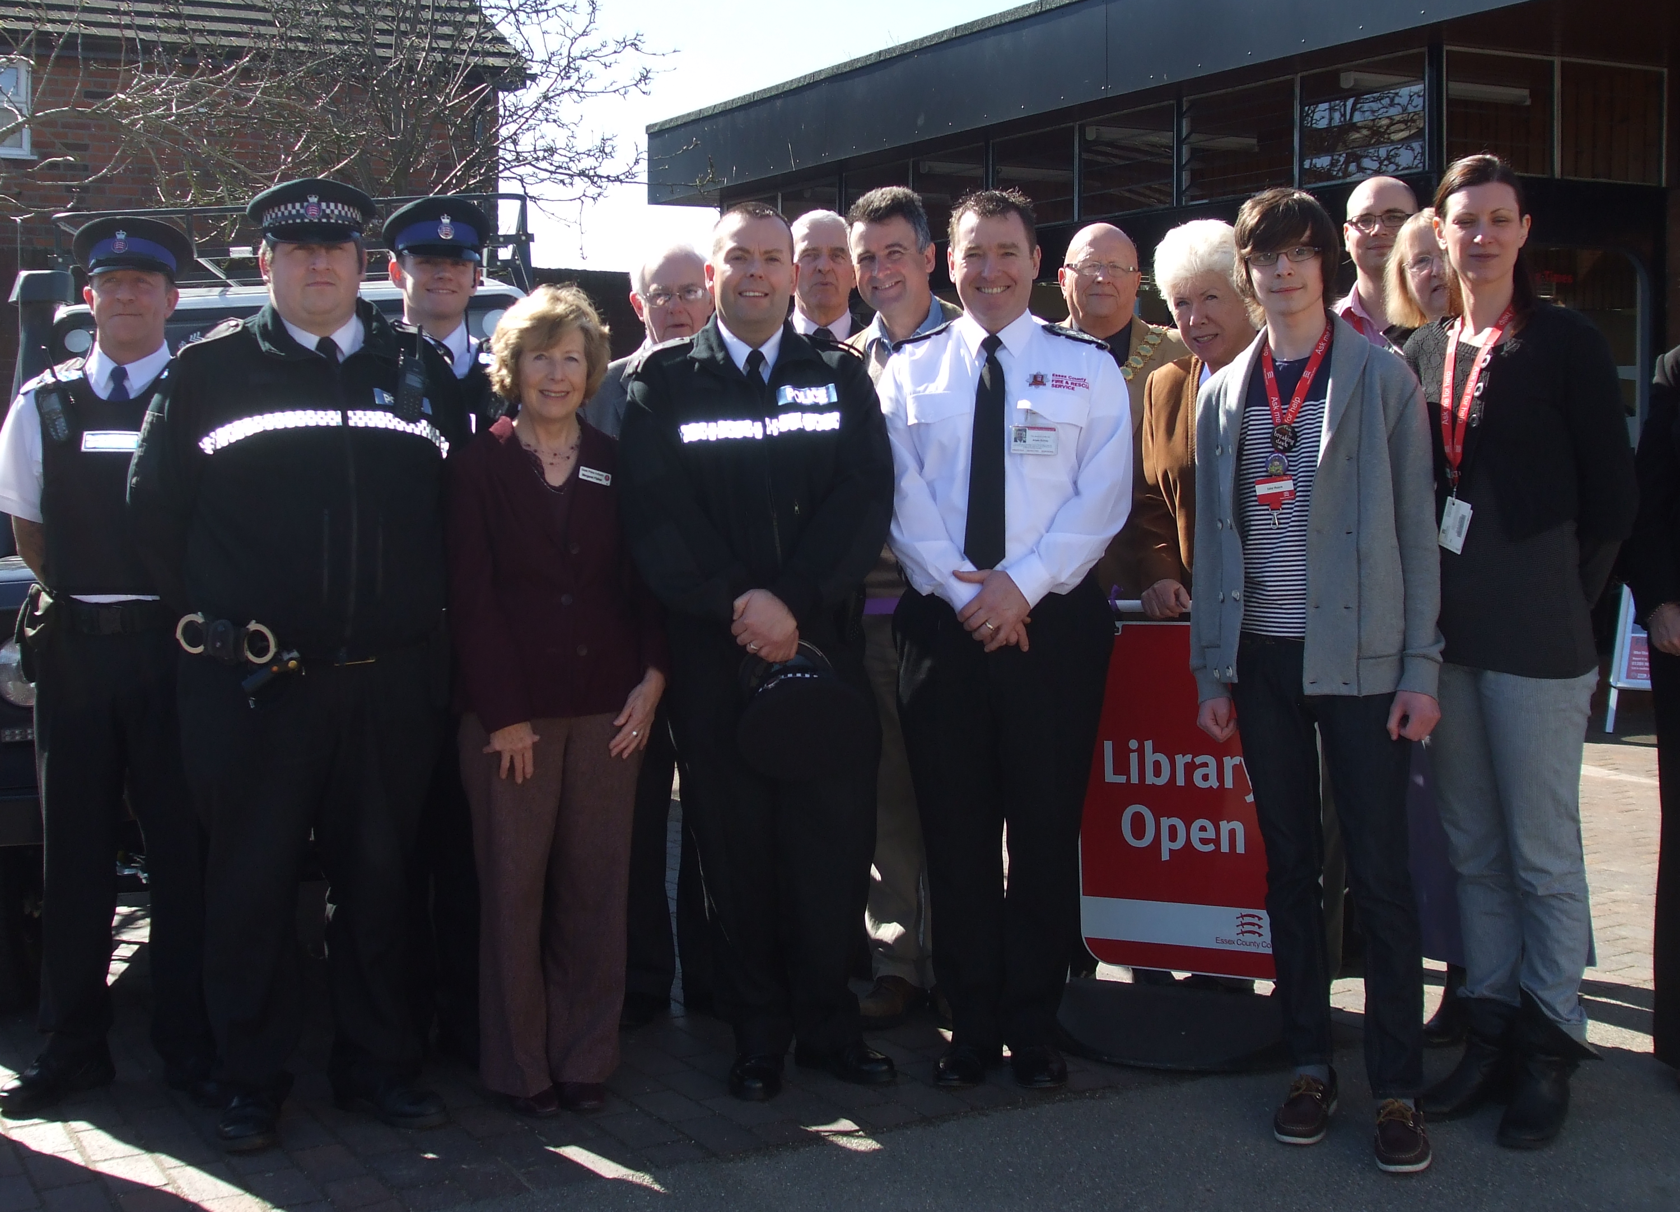
Partnership Working
Crucial to the effective local policing
Established Community Safety Partnerships
Joint problem solving track record
The right agency dealing with the issues
Opportunities to do more together – for example estates or front counters

