Slide 1
Essex Police Challenge Meeting
2nd July 2014
DRAFT 30.06.14

Slide 2
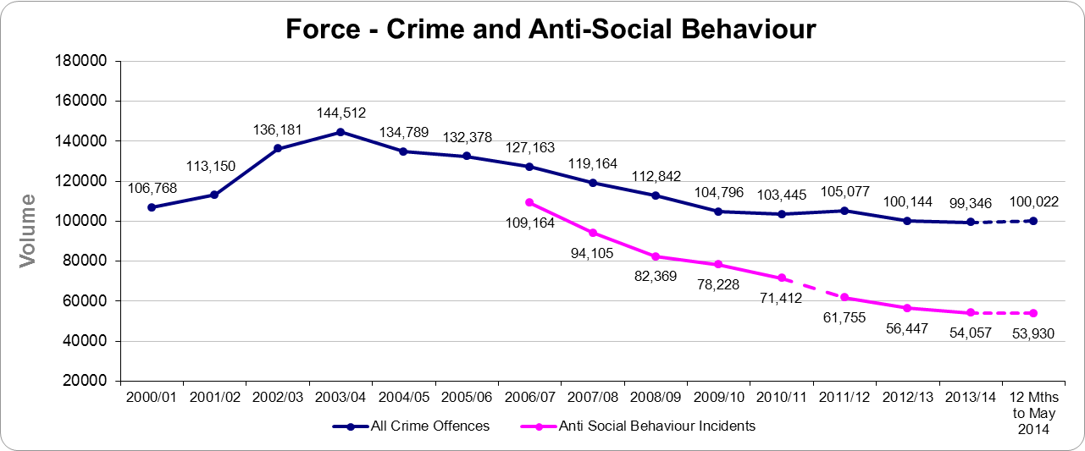
Reducing Crime and Anti-Social Behaviour

Slide 3
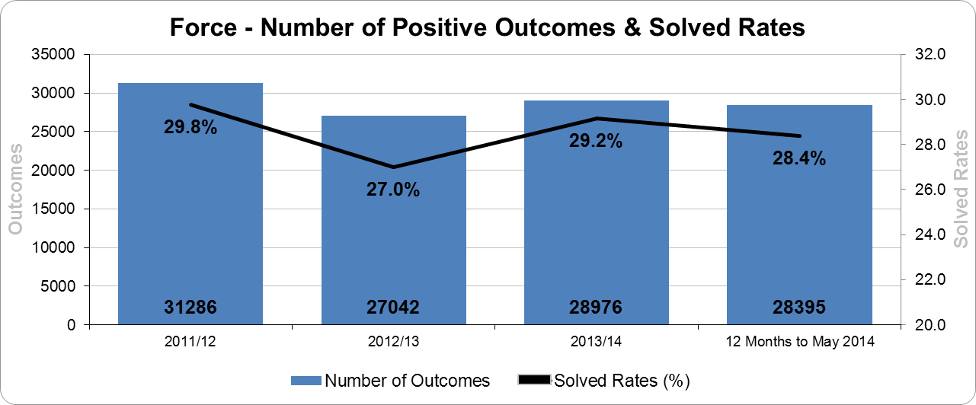
Solving Crime and Bringing Offenders To Justice

Slide 4
Promoting Satisfaction and Public Confidence
Rolling 12 months
User Satisfaction - Contact is 1.1% points better (94.5%)
User Satisfaction - Actions is 2.3% points better (82.9%)
User Satisfaction - Follow-up is 5.9% points better (78.0%)
User Satisfaction - Treatment is 0.5% points worse (92.1%)
User Satisfaction - Overall is 2.9% points better (82.2%)
Crime Survey for England and Wales
% Agree ‘Dealing with local concerns’ - 56.60%
% Agree ‘Confidence in the local police’ - 57.00%

Slide 5
Local Policing Model

Slide 6
Local Policing Hubs
1 hub per policing district
Led by new Local Policing and Partnership Inspector.
Work closely with the local policing shifts.
Contains licensing officers, crime prevention officers, neighbourhood watch & ASB co-ordinators (1 per LPA), youth officers.
Responsible for partnership, public engagement, ASB, long term problem solving of local issues as well as safeguarding of repeat and vulnerable victims.

Slide 7
Public Engagement - Meetings
Public engagement is a key part of local policing.
The future structure and frequency needs to be consistent, sustainable and effective.
Weekly beat surgeries at public locations, led by Pc or PCSO
5/6 Local Policing meetings in each District in each 8 week cycle
Chaired by local Sergeant or above

Slide 8
Summer Policing Demand

Slide 9
Incident Demand

Slide 10
Southend: All Incidents

Slide 11
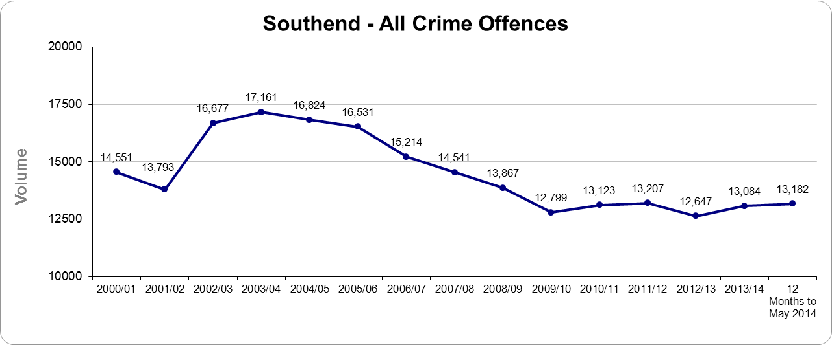
Southend Reducing Crime

